Slide 1
Python Presentation
Name :- Karan .L. Sharma.
PRN :- 202501100036.
Nested For Loop Control Instructions
With an example :-

Slide 2
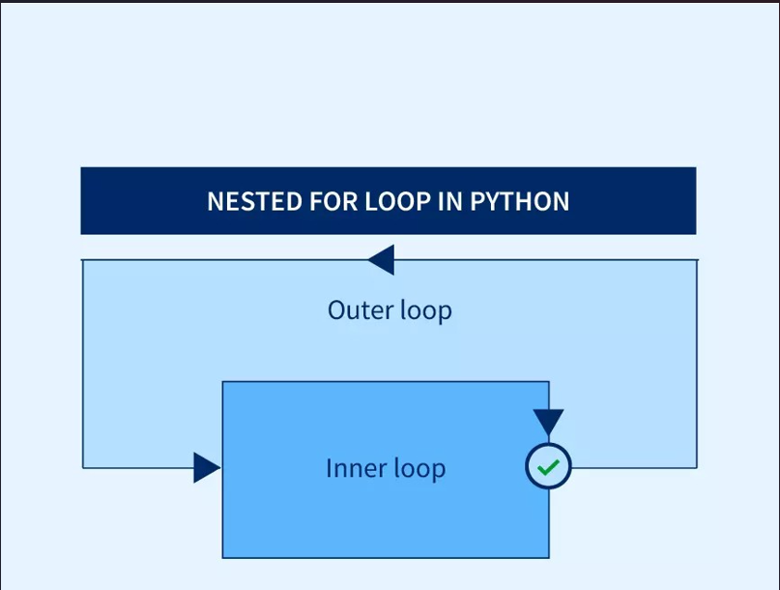
LEARNING OBJECTIVES Mechanism of for loop
Understand nested loop structure
and working.
Break down problems using logical
analysis.
Design efficient solutions using loops.
Apply nested loops to patterns and
real- world problems.

Slide 3
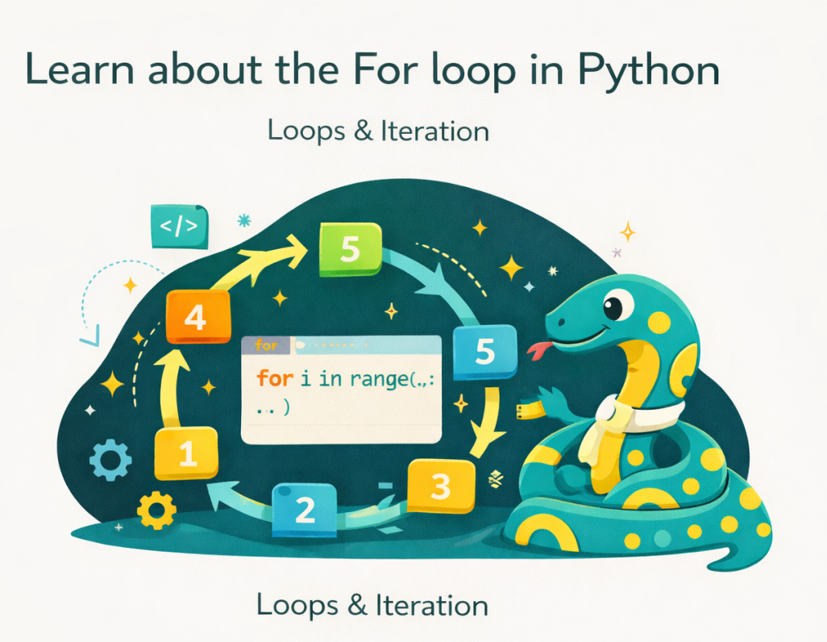
ENGINEERING KNOWLEDGE (CONCEPT)
A loop is used to repeat a set of instructions.
Types of loops in Python:
For loop – fixed numbers of iterations.
While loop – condition-based execution.
Loops help :-
Reduce code repetition.
Improve efficiency.

Slide 4
Engineering knowledge (Nested loop concept)
A nested loop is a loop inside another loop.
The inner loop executes completely for every iteration of the outer loop.
Important Concept:
If outer loop runs n times .
Inner loop runs m times
Total iterations = n * m

Slide 5
Syntax & structure
Python
for i in range(n):
for j in range(m):
#statements # Outer loop (rows)
i – controls outer loop (rows) # Inner loop (columns)
j – controls inner loop (columns)
Indentation is very important in
Python.

Slide 6
Execution flow (deep Understanding)
Step-by-step flow:
i = 0 j = 0,1,2 (inner loop
completes).
i = 1 j = 0,1,2 (inner loop
repeats).
Inner loop runs multiple times for
each outer loop iteration.
Example:
Python
for i in range(2):
for j in range(3):
print(i,j)

Slide 7
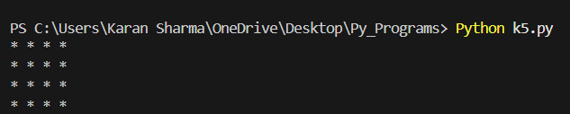
Problem STATEMENT
Task :-
Print a 4x4 square pattern using
stars.
This problem requires handling
rows and columns
simultaneously.
Expected Output

Slide 8
Problem analysis
Identify components:
Number of rows = 4.
Number of columns = 4.
Logical Mapping:
Outer loop >> controls rows.
Inner loop >> controls columns.
Same output repeated > fixed
Pattern.

Slide 9
Design of Solution (algorithm)
Step-by-step algorithm :-
Start outer loop for rows (0 to 3).
Inside it, start inner loop for columns (0 to 3).
Print * in inner loop.
After inner loop ends >> move to
next line
This creates a structured grid output.

Slide 10
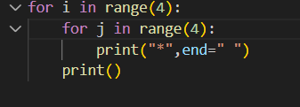
Code implementation
Code executed on Visual Studio Code
Python code :-

Slide 11
Explanation + Complex Problem
Explanation :-
Outer loop >> runs 4 times (rows).
Inner loop >> prints 4 starts per
row.
end = “ ” keeps stars on same line.
print() moves to next line.

Slide 12
ADVANCED Concepts + ethics + conclusion
Advanced Concepts
Used in :-
2D arrays (matrices).
Game grids.
Image processing.
Time Complexity : 0(n^2) (for equal
loops).
Professional Ethics :-
Write clean and readable code.
Maintain proper indentation.
Avoid unnecessary nested loops
(performance issue).
Test code for different inputs.

Slide 13
CONCLUSION
Nested loops are powerful for solving structured and complex problems.
They help convert logic into organized code.
Essential concept in programming and real-world applications.
THANK YOU

